Slide 1
Matrix Operations Header File
Group 6: Jayan S - 23033
KS Jagan - 23034
Krish S - 23040
Keerthivasan S V - 23037

Slide 2
Introduction - Header Files
A header file is a file that is programmed in the C language, which contains a set of predefined functions implemented for a specific purpose, with a “.h” extension
An example is the “stdio.h” header file which is included in the beginning of a majority of C programs, and is the short form of “Standard(std) Input(i) Output(o)”, and contains the basic input and output functions such as “printf” and “scanf”
Header files can either be standard, meaning they are stored in the default directory of the compiler, or non-standard, which have been manually defined by the user, like this project

Slide 3
Introduction - Matrix Operations
Matrices have a few basic algebraic operations, including addition, subtraction, scalar multiplication/division
However, they also have unique operations, consisting of transpose, inverse, matrix multiplication, etc.
To provide additional functionality to the user, the header file will contain all the before mentioned operations, as well as the sums of the rows, columns, diagonal and anti-diagonal for square matrices

Slide 4
Problem Statement
The C programming language has a lack of compatibility with N-dimensional arrays , compared to more recently developed programming languages such as Python. For an example, an array cannot be outputted using a single print(f) statement.
However, C possesses an inherent solution to this problem and many others of a similar variety. Header Files. Through the utilization of header files, as well as our knowledge of matrix operations, we can bridge the gap between C and array manipulation.
Our goal is to supplement C using a header file to perform matrix operations.

Slide 5

Functionality
Here are a few benefits of using header files:
Modularity – allows the user to separate pieces of code into modules, making them independent and less prone to errors
Code Reusability – code can be used multiple times without needing drastic modification
Compilation Efficiency – since there is no need to define functions, the code can be compiled faster
Documentation and Readability – removing the need for defining functions reduces the amount of code and thus improves readability and makes documentation more efficient

Slide 6
Index of functions used
MatrixSum
MatrixDifference
MatrixScalarMult
MatrixMult
MatrixTranspose
MatrixElementSum
MatrixRowSum
MatrixColumnSum
MatrixDiagonalSum
MatrixAntiDiagonalSum
SymmetryMatrix
OrthogonalityMatrix
MatrixDeterminant
InvertibilityMatrix

Slide 7
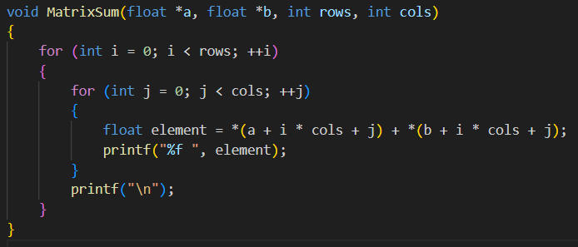
MatrixSum

Slide 8
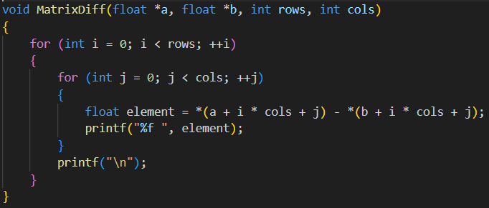
MatrixDiff

Slide 9
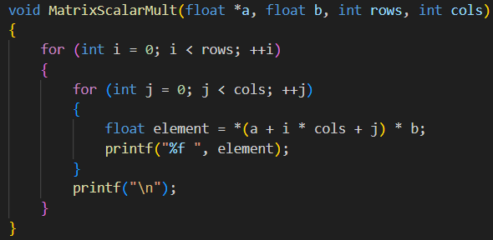
MatrixScalarMult

Slide 10
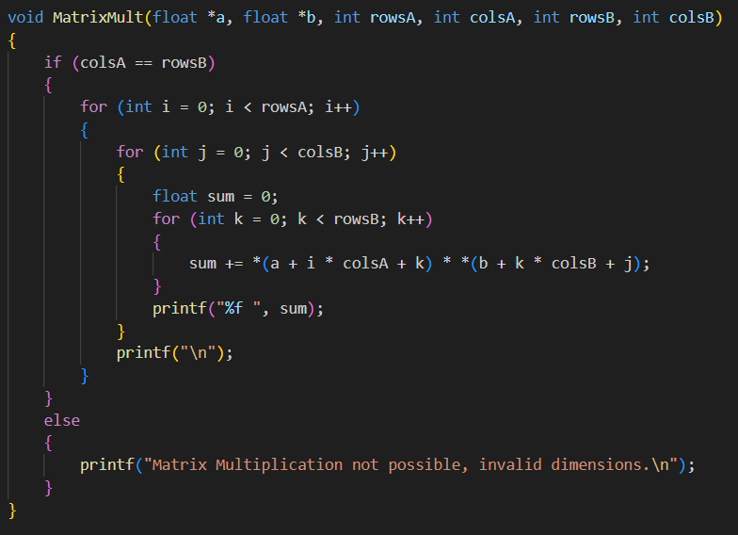
MatrixMult

Slide 11
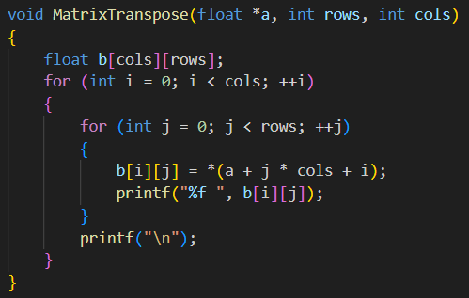
MatrixTranspose

Slide 12
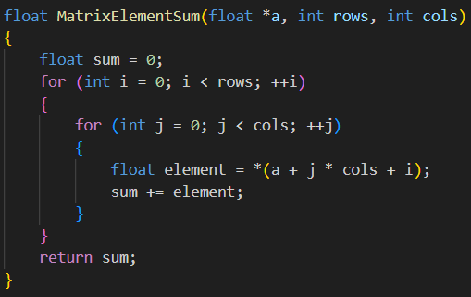
MatrixElementSum

Slide 13
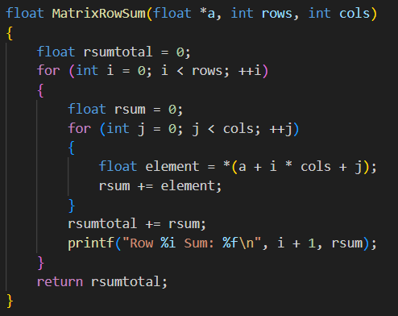
MatrixRowSum

Slide 14
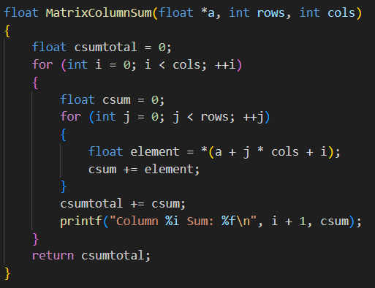
MatrixScalarMult

Slide 15
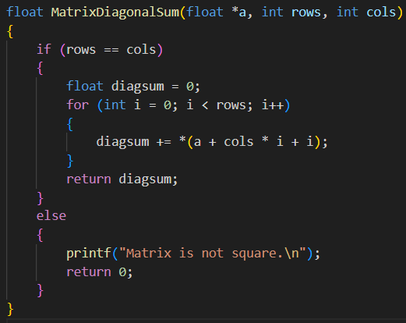
MatrixDiagSum

Slide 16
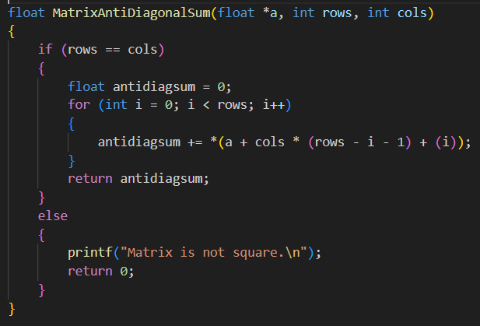
MatrixAntiDiagSum

Slide 17
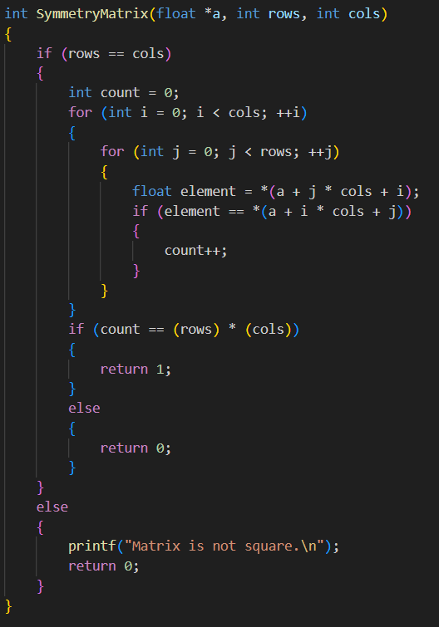
SymmetryMatrix

Slide 18
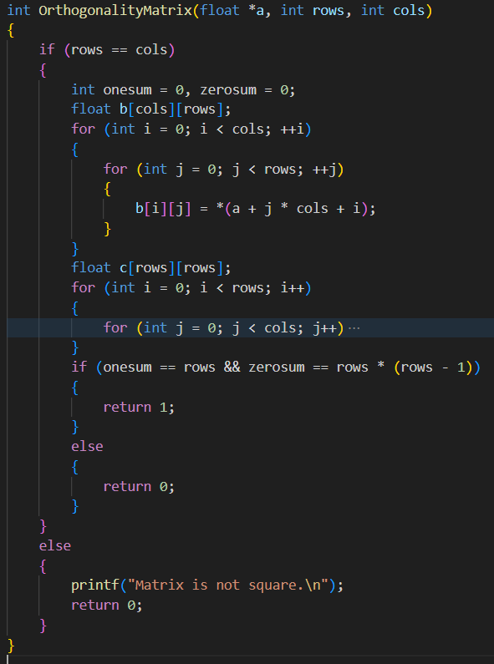
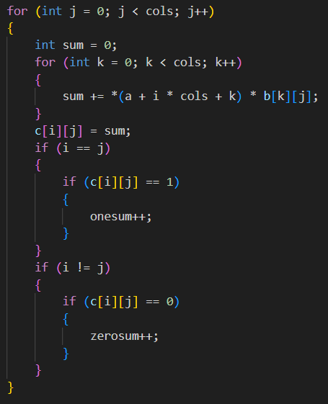
OrthogonalityMatrix

Slide 19
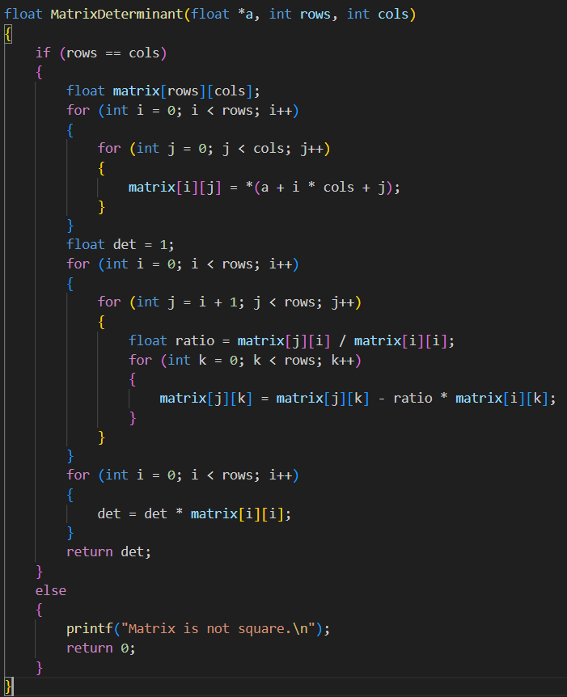
MatrixDeterminant

Slide 20
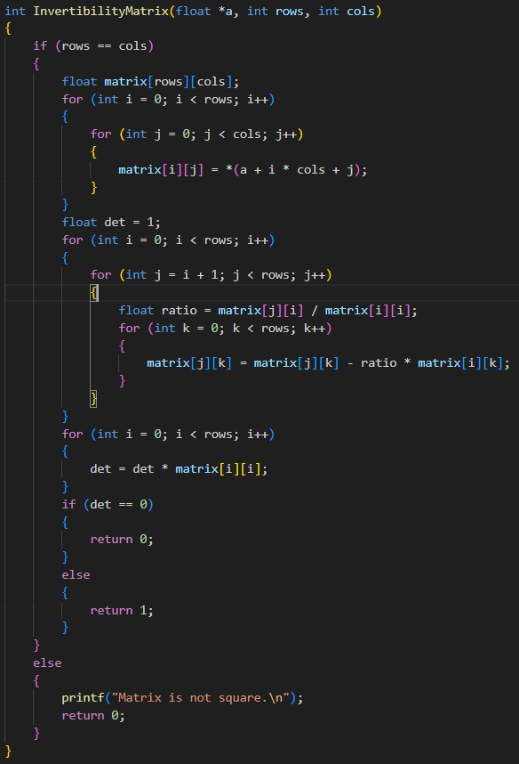
InvertibilityMatrix

Slide 21

References
Articles:
https://www.geeksforgeeks.org/header-files-in-c-cpp-and-its-uses/
https://www.tutorialspoint.com/cprogramming/c_header_files.htm
https://www.geeksforgeeks.org/write-header-file-c/
The functions have been created using our knowledge of linear algebra along with the class exercises, assignments, and various other evaluations.

